Slide 1
Concept & use of Cyber Hygiene in daily life
Advice for Individuals and Businesses
By: Ms. Darshana Tambe
Assistant Professor
Dept. of IT
VPPCOE & VA

Slide 2
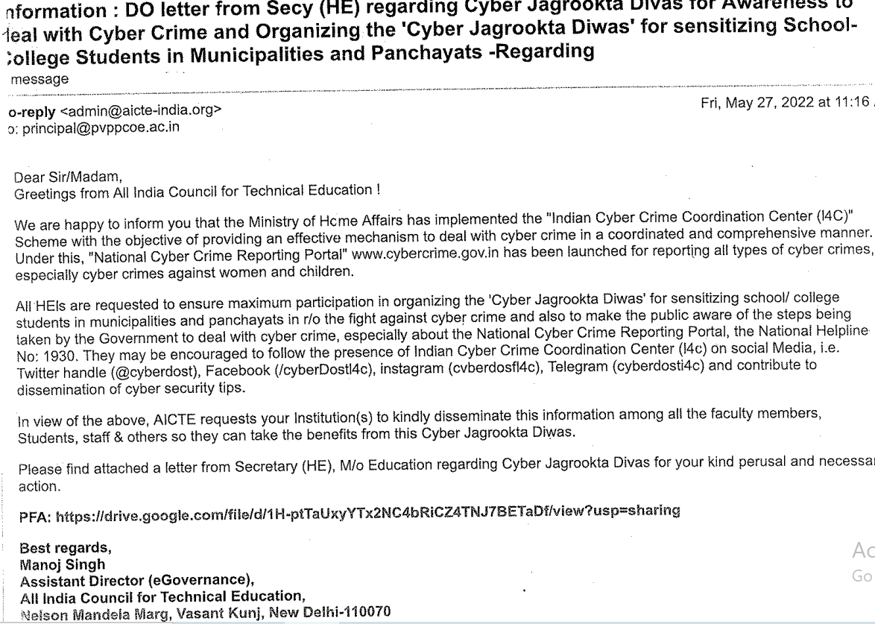
“Cyber Jagrookta Diwas”

Slide 3
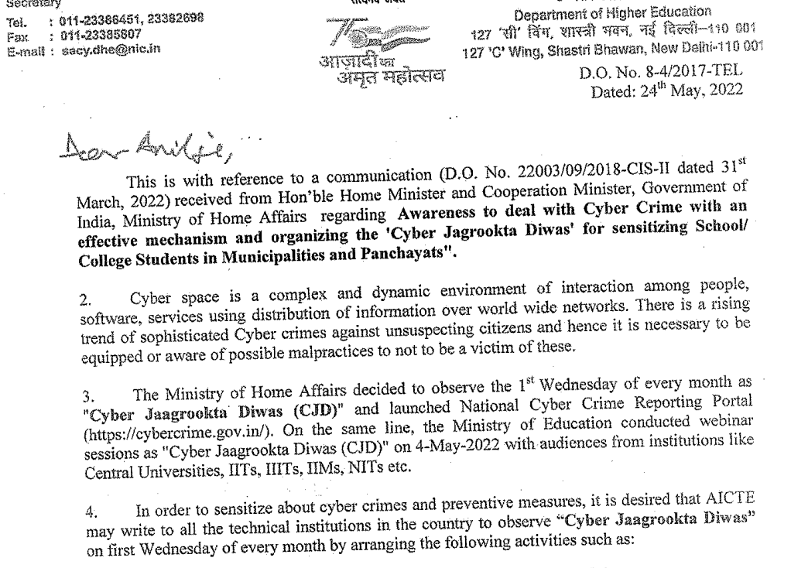

Slide 4
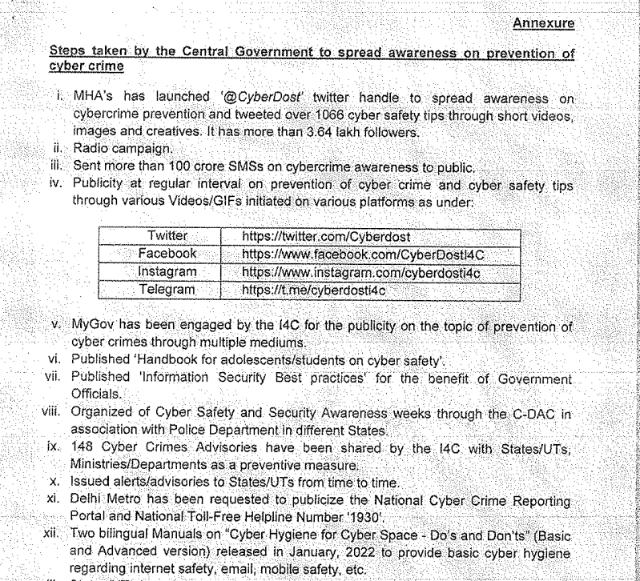

Slide 5
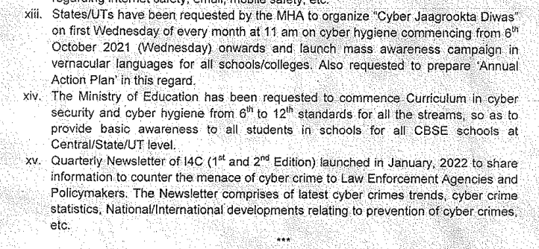

Slide 6
Introduction to Cybercrime

Slide 7
Contents
Introduction to Cybercrime:
Cybercrime definition and origins of the world
Cybercrime and information security
Classifications of cybercrime
Cybercrime and the Indian ITA 2000
A global Perspective on cybercrimes
Cyber hygiene

Slide 8
Introduction to Cybercrime
In recent era phenomenal growth of the Internet.
Use of internet for E-Comm.
Business dependency on internet , increase use of computer in daily life has open the door for cybercrime.
Like other developed and developing country, India is also victim of cyber crime .
Rapid growth of Cyber crime

Slide 9
How Many Cyber Attacks Happen per Day in 2022?
Globally, 30,000 websites are hacked daily.
64% of companies worldwide have experienced at least one form of a cyber attack.
There were 20M breached records in March 2021.
In 2020, ransomware cases grew by 150%.
Email is responsible for around 94% of all malware.
Every 39 seconds, there is a new attack somewhere on the web.
An average of around 24,000 malicious mobile apps are blocked daily on the internet.

Slide 10
Cybercrime
A crime conducted in which a computer was directly and significantly instrumental.
Alternate definition of cybercrime
1. Any Illegal act where special knowledge of computer is
essential. ( Computer Vulnerability).
2. Traditional act has taken new dimension by using technology
3. Any financial dishonesty that take place in computer env.
4. Threats to computer, theft and damage of software /hardware.

Slide 11
Cybercrime Definition
Cybercrime means performing a criminal act using cyberspace as a communication vehicle.
Cyberspace is the electronic medium of computer networks, in which online communication takes place.
Example of cybercrime
1. Tampering computer source document ( loss of integrity.)
2. Tampering information over transit.
3. Hacking with computer system. (steal /damage of info.)
4. Unauthorized access of computer.
5. Obtain / illegal publish of digital signature (PKI).

Slide 12
Cybercrime…..
Internal /External cybercrime.
Cyberterrorism : It is define as any persons, group or organization who, with terrorist intent utilize access or aids in accessing computer or computer network or electronics system or electronics device by any available means ,and thereby knowingly engage in or attempts to engage in a terrorist act.
Cyberterrorism is the use of Internet based attacks in terrorist activities, including acts of deliberate, large-scale disruption of computer networks, especially of personal computers attached to the Internet, by the means of tools such as computer viruses.

Slide 13
Cybercrime and Information Security
Lack of information security gives rise to cybercrime.
Vulnerability in system / unprotected communication /security compromise at sender and receiving end gives birth to cybercrime.
Cybersecurity : Cybersecurity means protection of information, equipments, devices, computer ,computer resource , communication devices, unauthorized access and use of information stored in computer, disclosure, disruption, modification or destruction.

Slide 14
Cybercriminals
Cybercrime involves activities,
- child pornography
- credit card fraud
- defacing web site
- gaining unauth. access of computer ,online info.
- ignoring /breaking s/w licenses , stealing of
identity.
Types of cybercriminals
1. Cybercriminals -hungry for recognition.
2. Cybercriminals– gain financial benefits.
3. Cybercriminals– insider

Slide 15
Classification of cybercrime
Cybercrime against individual
- E mail spoofing and online fraud. : A spoofed E-mail is one that appear to originate from one source but actually has been send from another source.
- Phishing
- Spamming : People who create electronics spam are called spammers. ( Bulk mail )
- Cyber defamation (insult) : Computer is used for defamation. ( spoken word , action, body language )
- Cyber Stalking and harassment : Cyber Stalking is the use of the internet or other electronic means to harass an individual, a group of individuals, or an organization.

Slide 16
Classification of cybercrime
- Computer Sabotage (disturb): To hamper the functionality of computer by introducing virus, worms or logic bomb ,is refer to as computer sabotage.
-Pornographic offenses .
-Password sniffing.
- Attacker will sniff credential (Password).
- Cybercrime against property
- Credit card fraud.
- Intellectual Property fraud.
- Illegal use of software /hardware.
- violation of copyright

Slide 17
Classification of cybercrime
Cybercrime against organization
- Unauthorized access of computer.
- Password sniffing.
- DoS. ( resource and service denial )
- Virus attack/ dissemination (broadcasting )of Virus.
- E-mail bombing / mail bomb.
- salami attack ( an attacker steals the money in small amounts.)
- logic bomb - Trojan Horse(a type of malware that downloads onto a computer disguised as a legitimate program)
- Data diddling. – In this attack , data is changed just before processing and change it back after the processing is completed. ( airline reservation system)

Slide 18
Classification of cybercrime
Cybercrime against society
- Forgery : Print/generate fake currency notes ,stamp paper, revenue stamp using high quality computer, printer , scanner.
- Cyber terrorism
- Web Jacking – Web Jacking occurs when someone forcefully takes control of web site ( by creaking password and later changing it). Website owner does not have control on web site and contents which appearing on it.

Slide 19
Why is Cyber Awareness Important?
Cyber crime is a growing trend
Raise awareness of threats
As with most crimes the police can’t tackle this problem alone
To encourage reporting
Promote Government backed scheme ‘Cyber Essentials’
Cyber crime is massively under reported.

Slide 20
How Cyber crime affects the India
CERT-In (The Indian Computer Emergency Response Team) reported more than 2.12 Lakhs cyber security incidents till February, 2022
The numbers were stated in a written reply by the Minister of State for Electronics and Information Technology, Rajeev Chandrasekhar in Lok Sabha
In comparison, the CERT-In reported more than 14.02 Lakhs cyber security related incidents in total last year.
In February of 2021, it was reported that hackers stole the personal data of 4.5 Mn Air India passengers.
In November last year, a cybersecurity firm had alleged that the personal and financial information of nearly 180 Mn PNB customers was left exposed for 7 months.
A Cisco report last year had stated that Some Indian SMEs lost up to INR 7 Cr in cyber attacks between September 2020-September 2021.

Slide 21
Common threats - Ransomware
Normally loaded onto a computer via a download/attachment/link from an email or website.
Will either lock the screen or encrypt your data.
Once Ransomware is uploaded on your computer/tablet/phone it is very difficult to remove without removing all of the data
Wannacry attack 2017 - One of the biggest cyber attacks to occur.
Is said to have hit 3,00,000 computers in 150 countries.
Companies affected include; NHS, Renault, FedEx, Spanish telecoms and gas companies, German railways.

Slide 22
How to tackle Ransomware
Back up- Keep a backed up copy of your data. Ensure its not permanently connected to the network.
Patch- Keep your software up to date. Wannacry was successful as those affected computers hadn’t updated. The update contained a fix for the problem.
Attachments- Don’t click on links from emails/SMS as this could easily be from an untrusted source and contain malware like Ransomware

Slide 23
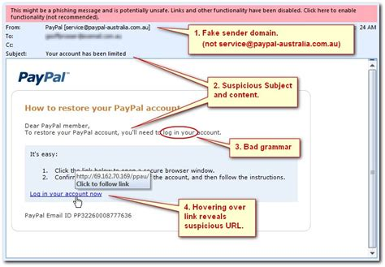
Phishing
Is the attempt to obtain sensitive information by deception.
They will be after your login credentials, payment card details or to upload malware to your computer
The email will normally impersonate a genuine company or person.
How to tackle the problem
Don’t click any links on an email unless you can guarantee who its from.
Use a trusted method of contacting the company via a phone number, app or website.
Mark the email as spam and contact the organisation.

Slide 24
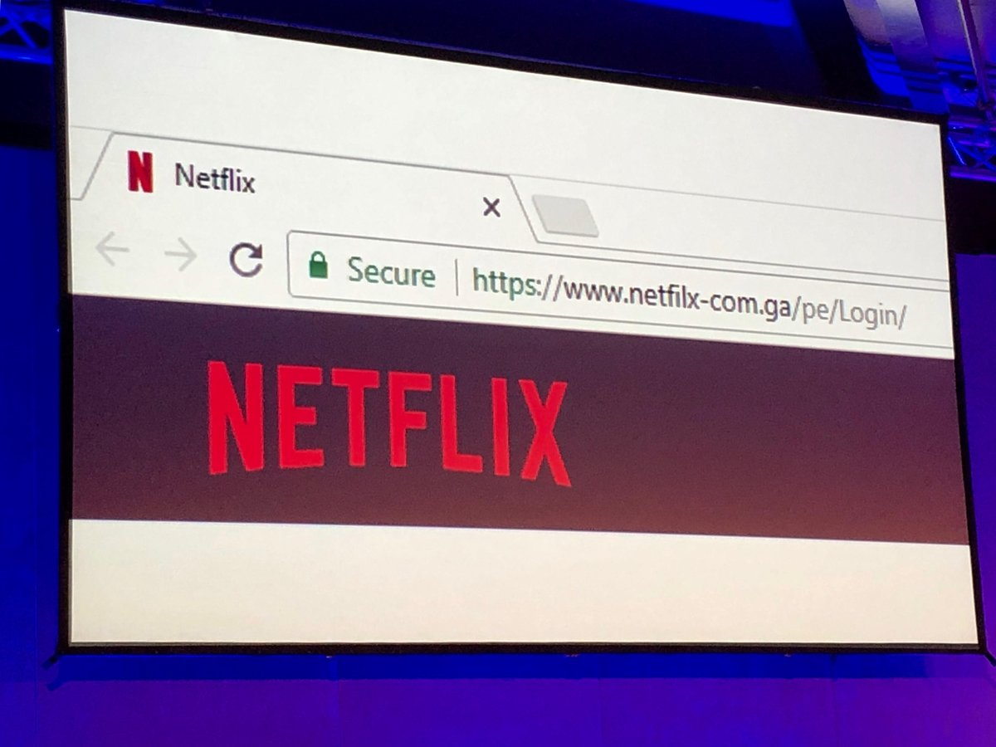
What to look out for when shopping on the internet?
Ensure you’re on the correct website
HTTPS and the padlock- The ‘S’ stands for secure, this means you have a secure connection to the website. This should prevent a ‘man in the middle’ attack. It encrypts your data and the receiver will be able to decrypt it but if it is a fraudulent website they will still obtain your information.
Use a credit card/ PayPal when conducting online transactions.

Slide 25
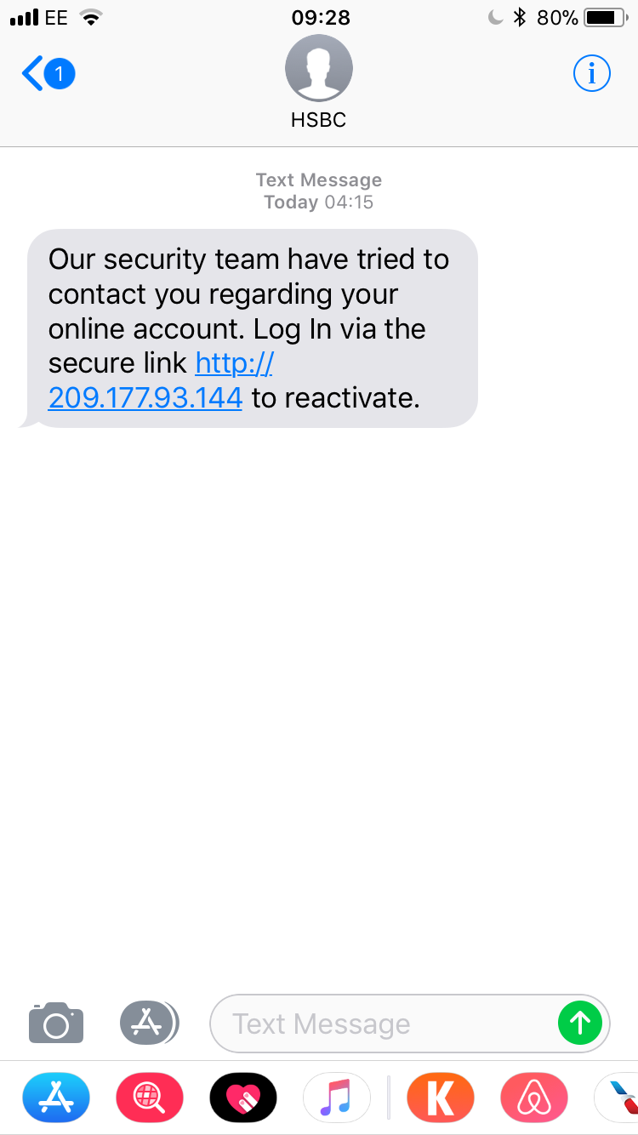
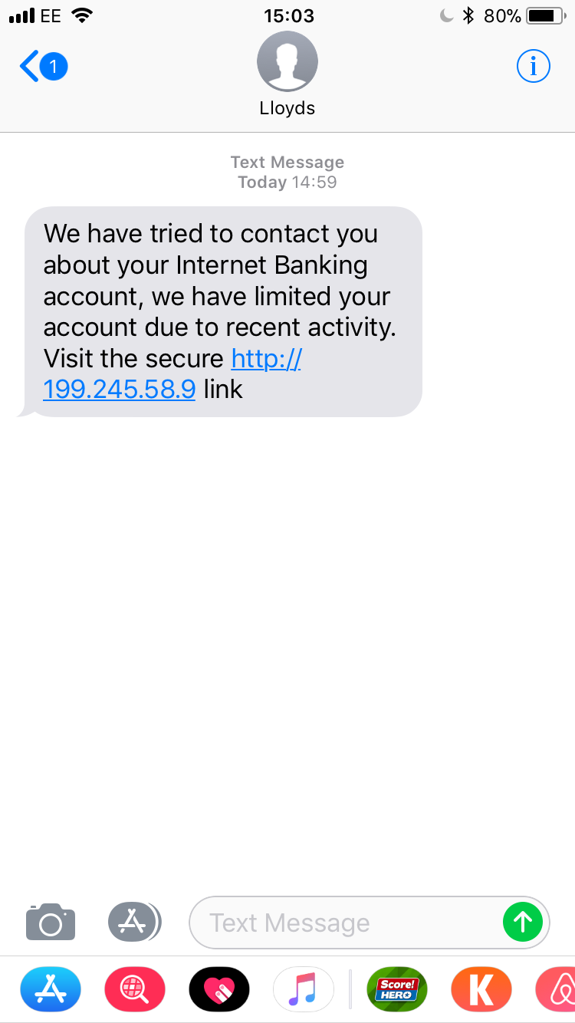

Slide 26
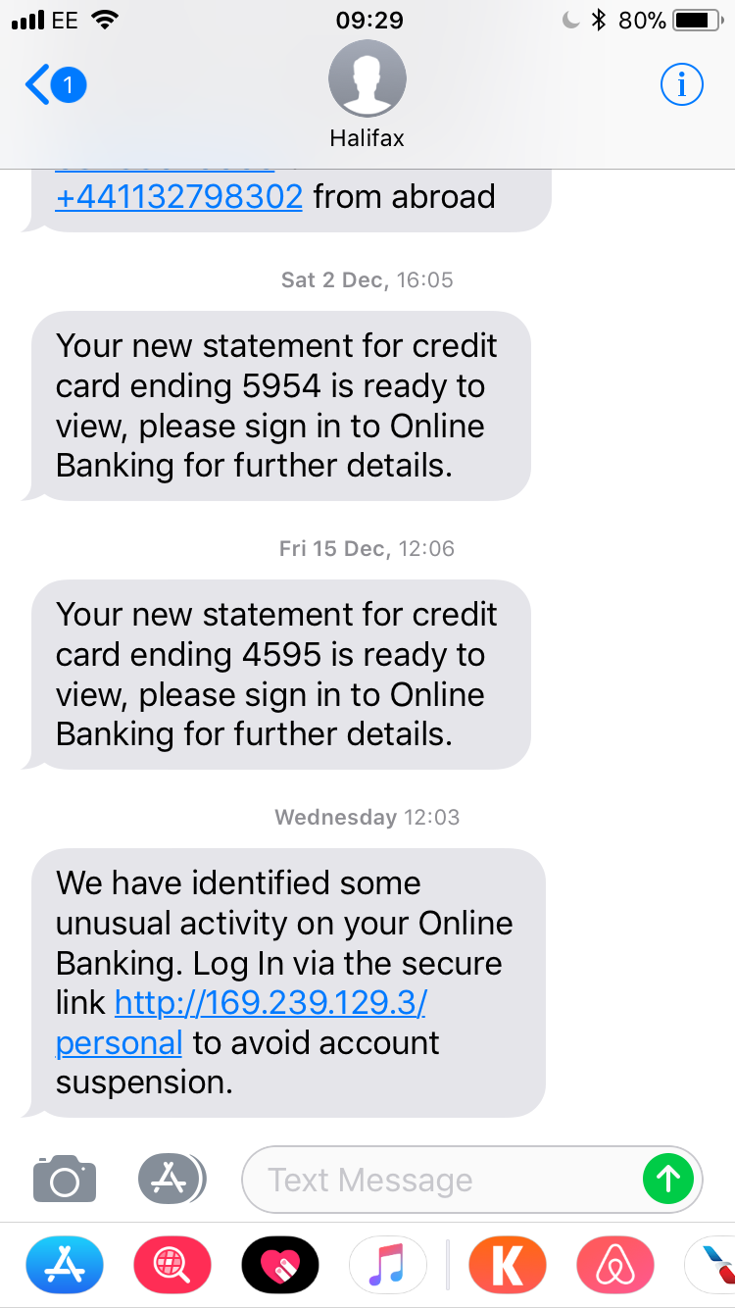

Slide 27
Public Wi-Fi
May not be trustworthy. They could share your information to other companies who operate in countries without any data protection.
You may not know who is watching you whilst you’re online.
What to do and not do to
Don’t use online banking. Use your own data.
Don’t conduct any purchases
Use a virtual private network (VPN)

Slide 28
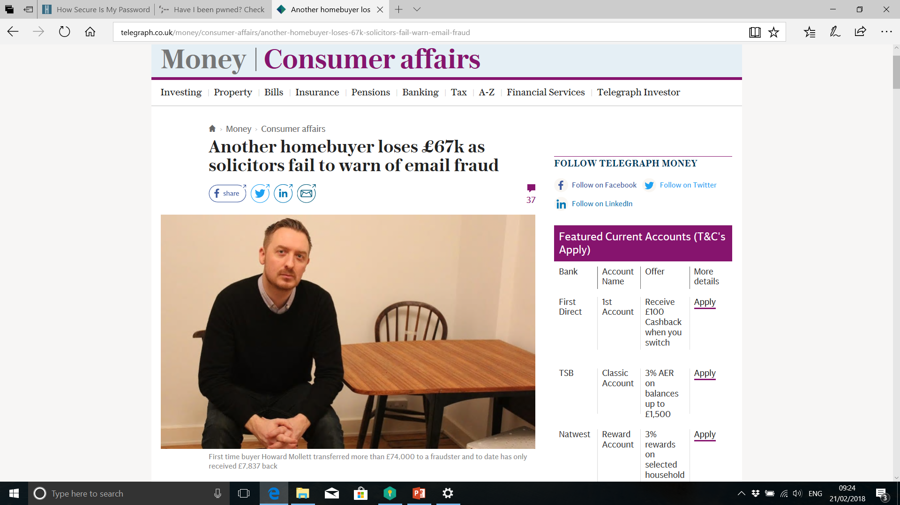

Slide 29
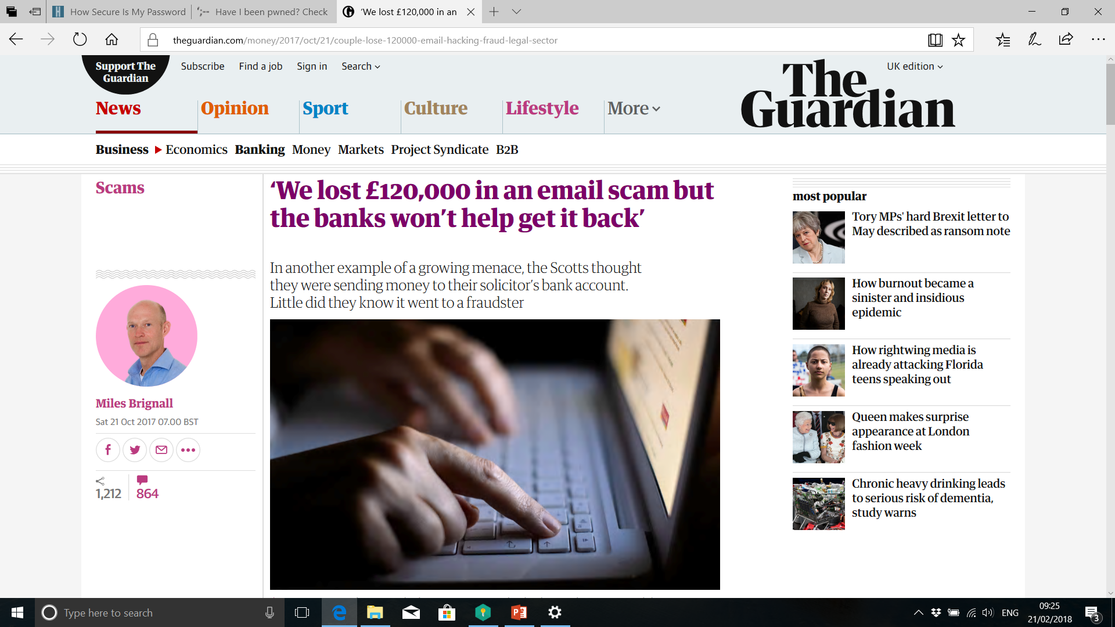

Slide 30
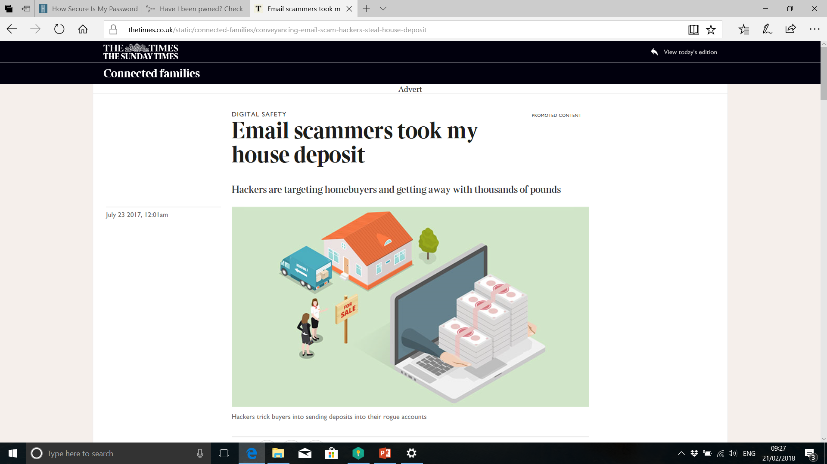

Slide 31
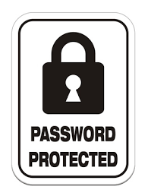
Passwords Advice
Use 1 password per account.
Three random words is the NCSC’s advice. Capitals, special characters and numbers is your own choice.
If you follow this advice your passwords security will be significantly increased against a brute force attack.
Password managers can be helpful to store your passwords.

Slide 32

Advice
In the physical world we’re good at protecting ourselves and our property, we need to replicate this in the digital world.
80% of cyber-crime is preventable.
QR Codes

Slide 33
Advice
Update and migrate
Activate your firewall
Staff awareness
Data encryption
User accounts privileges i.e admin
Cyber insurance
Prepare Plan

Slide 34
What support is there for Businesses and the Public?

Slide 35
Reporting Cybercrime
You can report a cyber crime by
filing a complaint in nearest/any Cyber cell,
lodging an FIR in a police station.
filing a complaint a https://cybercrime.gov.in

Slide 36

Need of Cyberlaw
Indian Parliament has passed cyber law ITA 2000 with aim to provide legal infrastructure for E-commerce.
Framework created to give legal recognition to all risk arising due to computer and computer network.
To have some legal recognition to the Internet as it is one of the most dominating sources of carrying out business in today’s world
To protect against cyberterrorism as it came into existence with growth in internet

Slide 37

IT Act, 2000
India has adopt cyber laws on 17th May 2000
Cyber laws deals with the issues , legal consequences and conflict in the word of cyberspace, internet or WWW.
ICT(Information Technology Law) protect online transition.
It consist of 94 sections segregated into 13 chapters.

Slide 38
Objectives of the IT Act
To provide legal recognition for transactions:-
Carried out by means of electronic data interchange, and other means of electronic communication, commonly referred to as "electronic commerce“
To facilitate electronic filing of documents with Government agencies and E-Payments (on line tax payment , Income tax return, online service tax)
To amend (alter) the Indian Penal Code, Indian Evidence Act,1872, the Banker’s Books Evidence Act 1891, Reserve Bank of India Act ,1934

Slide 39
Cybercrime provisions under
IT Act,2000
Section | Offence
65 | Tampering with Computer source documents
66 | Hacking with Computer systems, Data alteration
67 | Publishing obscene information
71 | Misrepresentation
72 | Breach (break) of Confidentiality and Privacy
73 | Publishing false digital signature certificates
74 | Publication for fraudulent purpose

Slide 40
Section 65: Source Code
Offence | Penalty
Knowingly or intentionally concealing, destroying or altering any computer source code Computer Source Code means the listing of programmes, computer commands, design and layout Ingredients | Custody of 3 years Fine 2 lakhs

Slide 41
Section 66 : Hacking
Offence | Penalty
Intention or knowledge to cause wrongful loss or damage to the public or any person Destruction, deletion, alteration, diminishing value or utility or injuriously affecting information residing in a computer resource | Custody of 3 years Fine 2 lakhs

Slide 42
Sec. 67: Pornography
Offence | Penalty
Publishing or transmitting or causing to be published in the electronic form, Obscene material | On first conviction Imprisonment 5 years Fine 1 lakh
 | On subsequent conviction Imprisonment 10 years Fine 2 lakhs

Slide 43
Section 71: Misrepresentation to the Controller or the Certifying Authority
Offence | Penalty
Making any misrepresentation to, or suppression of any material fact from, the Controller or the Certifying Authority for obtaining any license or Digital Signature Certificate, as the case may be. | Imprisonment2 years Fine 1 lakhs

Slide 44
Section 72: Penalty for breach (break) of confidentiality and privacy
Offence | Penalty
Any person who, in pursuance of any of the powers conferred under IT Act, has secured access to any electronic record, book, register, correspondence, information or document without the consent of the person concerned discloses such electronic record, book., register, correspondence, information, document to any other person. | Imprisonment2 years Fine 1 lakhs

Slide 45
Section 73: Publishing Digital Signature Certificate false in certain particulars
Offence | Penalty
Publishing a Digital Signature Certificate or otherwise making it available to any other person with the knowledge that 1) The Certifying Authority listed in the certificate has not issued it or 2) The subscriber listed in the certificate has not accepted it or 3) The certificate has been revoked or suspended, unless such publication is for the purpose of verifying a digital signature created prior to such suspension or revocation. | Imprisonment 2 years Fine 1 lakhs

Slide 46
Section 74: Publication for fraudulent purpose
Offence | Penalty
Creation, publication or otherwise making available a Digital signature Certificate for any fraudulent or unlawful purpose | Imprisonment2 years Fine 1 lakhs

Slide 47
IT Amendment Bill 2008
ITAA 2008 is new version of ITA 2000 which provides additional focus on Information Security.
It has added several new sections on offences including Cyber Terrorism and Data Protection.
In the 2008 version of the Act, there are 124 sections (excluding 5 sections that have been omitted from the earlier version) and 14 chapters.

Slide 48


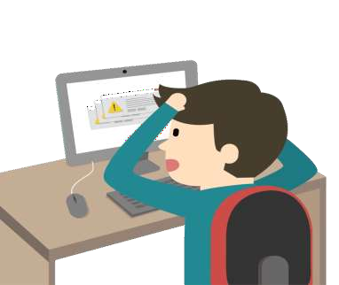
Cyber Hygiene
Golden Rules Of Netiquette

Slide 49
Introduction
Cyber hygiene is often compared to personal hygiene. Much like an individual engages in certain personal hygiene practices to maintain good health and well-being, cyber hygiene practices can keep data safe and well-protected.
In turn, this aids in maintaining properly functioning devices by protecting them from outside attacks, such as malware, which can hinder functionality.
Cyber hygiene relates to the practices and precautions users take with the aim of keeping sensitive data organized, safe, and secure from theft and outside attacks.

Slide 50
Definition of Cyber Hygiene
Cyber hygiene is a reference to the practices and steps that users of computers and other devices take to maintain system health and improve online security.
These practices are often part of a routine to ensure the safety of identity and other details that could be stolen or corrupted.
Much like physical hygiene, cyber hygiene is regularly conducted to ward off natural deterioration and common threats.

Slide 51
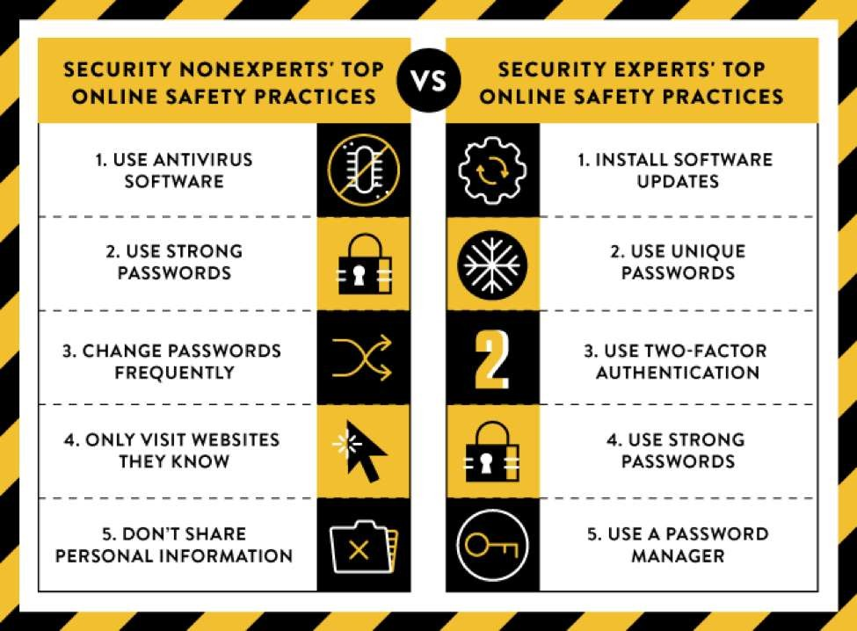

Cyber Hygiene

Slide 52
Benefits of Cyber Hygiene
Having a routine cyber hygiene procedure in place for your computers and software is beneficial for two distinct reasons – maintenance and security.
Maintenance is necessary for computers and software to run at peak efficiency.
Files become fragmented and programs become outdated, increasing the risk of vulnerabilities.

Slide 53
Benefits of Cyber Hygiene
Routines that include maintenance are likely to spot many of these issues early and prevent serious issues from occurring.
A system that is well-maintained is less likely to be vulnerable to cybersecurity risks.
Security is perhaps the most important reason to incorporate a cyber hygiene routine.
Hackers, identity thieves, advanced viruses, and intelligent malware are all part of the hostile threat landscape.
While predicting threats can be challenging, preparing and preventing them becomes feasible with sound cyber hygiene practices.

Slide 54
Common Cyber Hygiene Problems
Enterprises often have multiple elements in need of cyber hygiene.
All hardware (computers, phones, connected devices), software programs, and online applications used should be included in a regular, ongoing maintenance program.
Each of these systems have specific vulnerabilities that can lead to different problems. Some of these problems include:

Slide 55
Common Cyber Hygiene Problems
Loss of Data: Hard drives and online cloud storage that isn’t backed up or maintained is vulnerable to hacking, corruption, and other problems that could result in the loss of information.
Misplaced Data: Poor cyber hygiene could mean losing data in other ways. The information may not be corrupted or gone for good, but with so many places to store data, misplacing files is becoming increasingly commonplace in the modern enterprise.

Slide 56
Common Cyber Hygiene Problems
Security Breach: There are constant and immediate threats to all enterprise data. Phishing, hackers, malware, spam, viruses, and a variety of other threats exist in the modern threat landscape, which is constantly in a state of flux.
Out of Date Software: Software applications should be updated regularly, ensuring that the latest security patches and most current versions are in use across the enterprise – for all applications.
Out of date software is more vulnerable to attacks and malware.

Slide 57
Common Cyber Hygiene Problems
Older Security Software: Antivirus software and other security software must be updated continuously to keep pace with the ever-changing threat landscape.
Outdated security software – even software that has gone a few months without an update
– can’t protect the enterprise against the latest threats.

Slide 58
Best Practices: A Cyber Hygiene Checklist
While there are numerous threats and multiple vulnerabilities with each piece of the digital puzzle, creating a cyber hygiene routine isn’t as difficult as it may seem.
A few key practices implemented regularly can dramatically improve the security of any system.

Slide 59
Document All Current Equipment and Programs
All hardware, software, and online applications will need to be documented. Start by creating a list of these three components:
Hardware: Computers, connected devices (i.e. printers, fax machines), and mobile devices (i.e. smartphones,tablets).
Software: All programs, used by everyone on a particular network, that are installed directly onto computers.
Applications: Web apps (i.e. Dropbox, Google Drive), applications on phones and tablets, and any other program that isn’t directly installed on devices.

Slide 60
Analyze the List of Equipment and Programs
After creating a comprehensive list of all cyber-facing components, you can begin to scrutinize the list and find vulnerabilities.
Unused equipment should be wiped and disposed of properly.
Software and apps that are not current should be updated and all user passwords should be changed. If the programs aren’t in regular use, they should be properly uninstalled.
Certain software programs and apps should be chosen to be the dedicated choice for certain functions for all users. For instance, if both Google Drive and Dropbox are being used for file storage, one should be deemed primary and the other used as backup or deleted.

Slide 61
Create A Common Cyber Hygiene Policy
The newly clarified network of devices and programs will need a common set of practices to maintain cyber hygiene.
If there are multiple users, these practices should be documented into a set policy to be followed by all who have access to the network.
Here are typical items that should be included into a cyber hygiene policy:

Slide 62
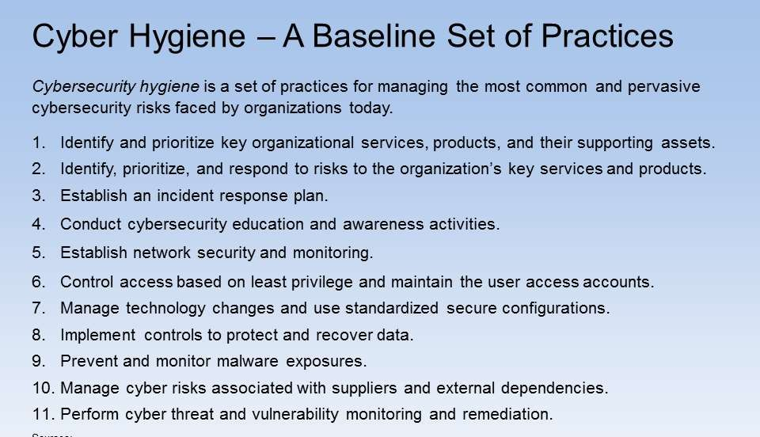

Create A Common Cyber Hygiene Policy

Slide 63
Create A Common Cyber Hygiene Policy
Password Changes: Complex passwords changed regularly can prevent many malicious activities and protect cyber security.
Software Updates: Updating the software you use, or perhaps getting better versions should be a part of your regular hygienic review.
Hardware Updates: Older computers and smartphones may need to be updated to maintain performance and prevent issues

Slide 64
Create A Common Cyber Hygiene Policy
Manage New Installs: Every new install should be done properly and documented to keep an updated inventory of all hardware and software.
Limit Users: Only those who need admin-level access to programs should have access. Other users should have limited capabilities.
Back Up Data: All data should be backed up to a secondary source (i.e. hard drive, cloud storage). This will ensure its safety in the event of a breach or malfunction.
Employ a Cyber Security Framework: Businesses may want to review and implement a more advanced system (e.g. the NIST framework) to ensure security.

Slide 65
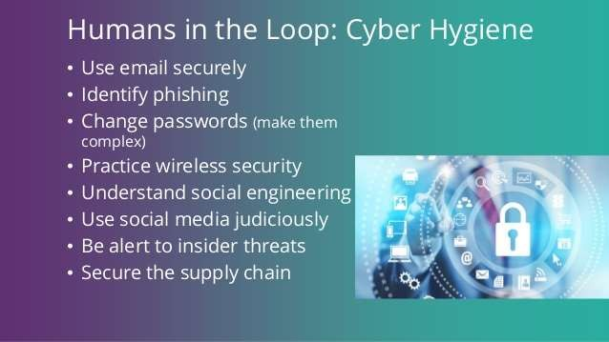

Create A Common Cyber Hygiene Policy

Slide 66
Create A Common Cyber Hygiene Policy
Once the policy is created, the routine for each item should be set to appropriate timeframes.
For instance, changing passwords every 30 days or check for updates at least once per week could be set in place.
Doing so will ensure the continued cyber hygiene of your entire network of hardware and software.

Slide 67
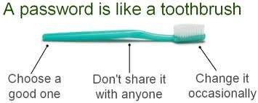

Create A Common Cyber Hygiene Policy

Slide 68
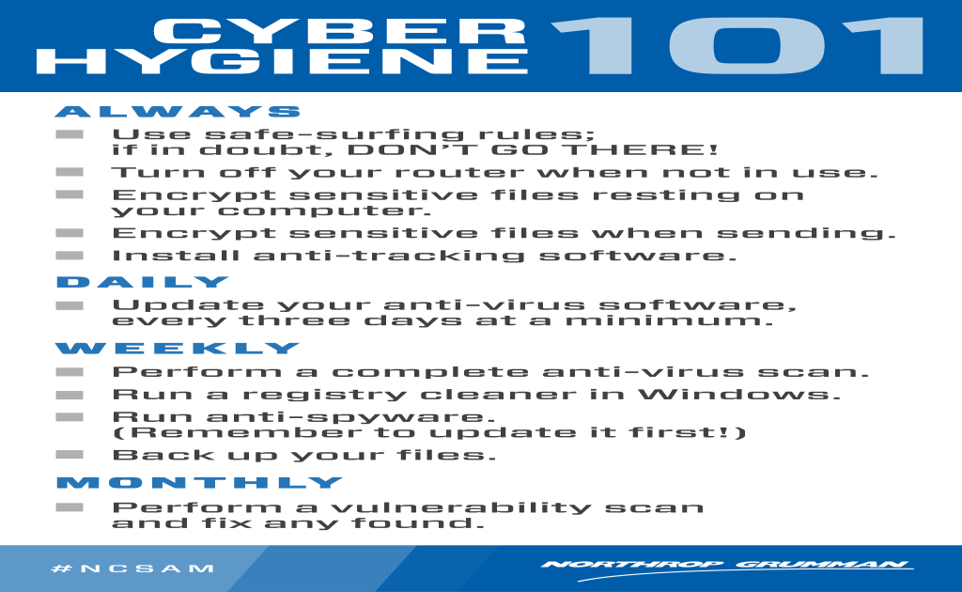


Slide 69
You are the best defence!
Technology is only a small part of Cyber Defence
You are the most important person – protect yourself
For businesses the most important and best defence is Cyber Security Aware employees – train your staff
Always be aware!
Always be on your guard!

Slide 70
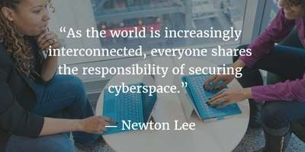


Slide 71
Link of feedback
https://forms.gle/VJt18iNABsiAKisB8

Slide 72
Thank you!!

